Slide 1
Researching Project IoT Platform using Laravel and Mobile App
‘ Week4 Report ’
Lecturer: Mr. HEL Chanthan
Prepared by Mr. VANNAK Sovannroth
2019-2020

Slide 2
Outline
Planning for First Month
Planning for Second Month
Creating User Login and Register
Starting apply Admin Template for User login
Starting apply Admin Template for Backend
Creating User (create, edit & delete) on backend connect to database
Creating Route of User, Category, Company, Social, and About
Creating Alert Message
PAGE 01

Slide 3
Planning for First Month
Activity (Start on 06.08.2020) | Thursday (Presentation day) | Friday | Monday | Tuesday | Wednesday (Meeting day)
Week 1 | Installation MongoDB (Shell and Compass) and connect localhost between Shell and Compass.(Locally) | Performing CRUD (Create, Read, Update, Delete) on Mongo Shell and MongoDB Compass. | Creating MongoDB Atlas account and connect it to Mongo Shell or MongoDB Compass, and Driver (Node.js).(Cloud) | Installation Visual Studio Code and connect driver to MongoDB Atlas.(Cloud) | Connecting sample Backend to MongoDB Cluster and storing Products in the Database.
Week 2 | Connecting driver to Mongo Shell.(Locally) | Starting to build sample backend connect with or without MongoDB Atlas. | Build creating, editing and deleting Products on server. | Transmitting and fetching data to/from the Database. | Creating Login and Signup. (Email and password)
Week 3 | Learning template Bootstrap 4 | Install wampserver and Laravel | Run Laravel server with MySQL(Database) | Choose free template Bootstrap for Front-End & Backend | Installation Laravel Module for Backend and Front-End
Week 4 | Starting to build backend for project. & Creating Login and Signup. | User management: • Create new user • Reset user password • Delete and edit user | Manage Info: • Logo • Name • Contact info • Map • Social | Manage new category: • Create new category • Edit and delete exiting categories. | Manage news: • Post news • Edit news • Delete news
PAGE 02

Slide 4
Planning for Second Month
Activity (Start on 06.08.2020) | Thursday (Presentation day) | Friday | Monday | Tuesday | Wednesday (Meeting day)
Week 5 | Create Dashboard | Create Dashboard | Manage Calculate: • Addition • Subtraction • Multiplication • Division | Write API & Read API | Write API & Read API
Week 6 | Connect to ESP8266 or NodeMcu & fetch data from Arduino | Get data from Sensors and Calculate. | Show data on Dashboard | Connect Backend to Front-End | Front-End fetch data from Backend
Week 7 | Choose Flutter or React Native for build Mobile App. | Learning Flutter or React native | Start build sample project | Create Horizontal list view & build recent products grid view. | Manage Info: • Product details • Home page Ui modification • Shopping cart & list page • User login & Register • Contact info
Week 8 | Creating Users, brand and category on database & Adding products to the database. | Auto complete search for categories and brands & Uploading Images to firebase. | Login and signup screen redesign & Google sign in for IOS and Android . | Firebase Auth using provider package & Dashboard UI/UX and Database product modeling. | Load products from firebase part & loading products from database.
PAGE 03

Slide 5
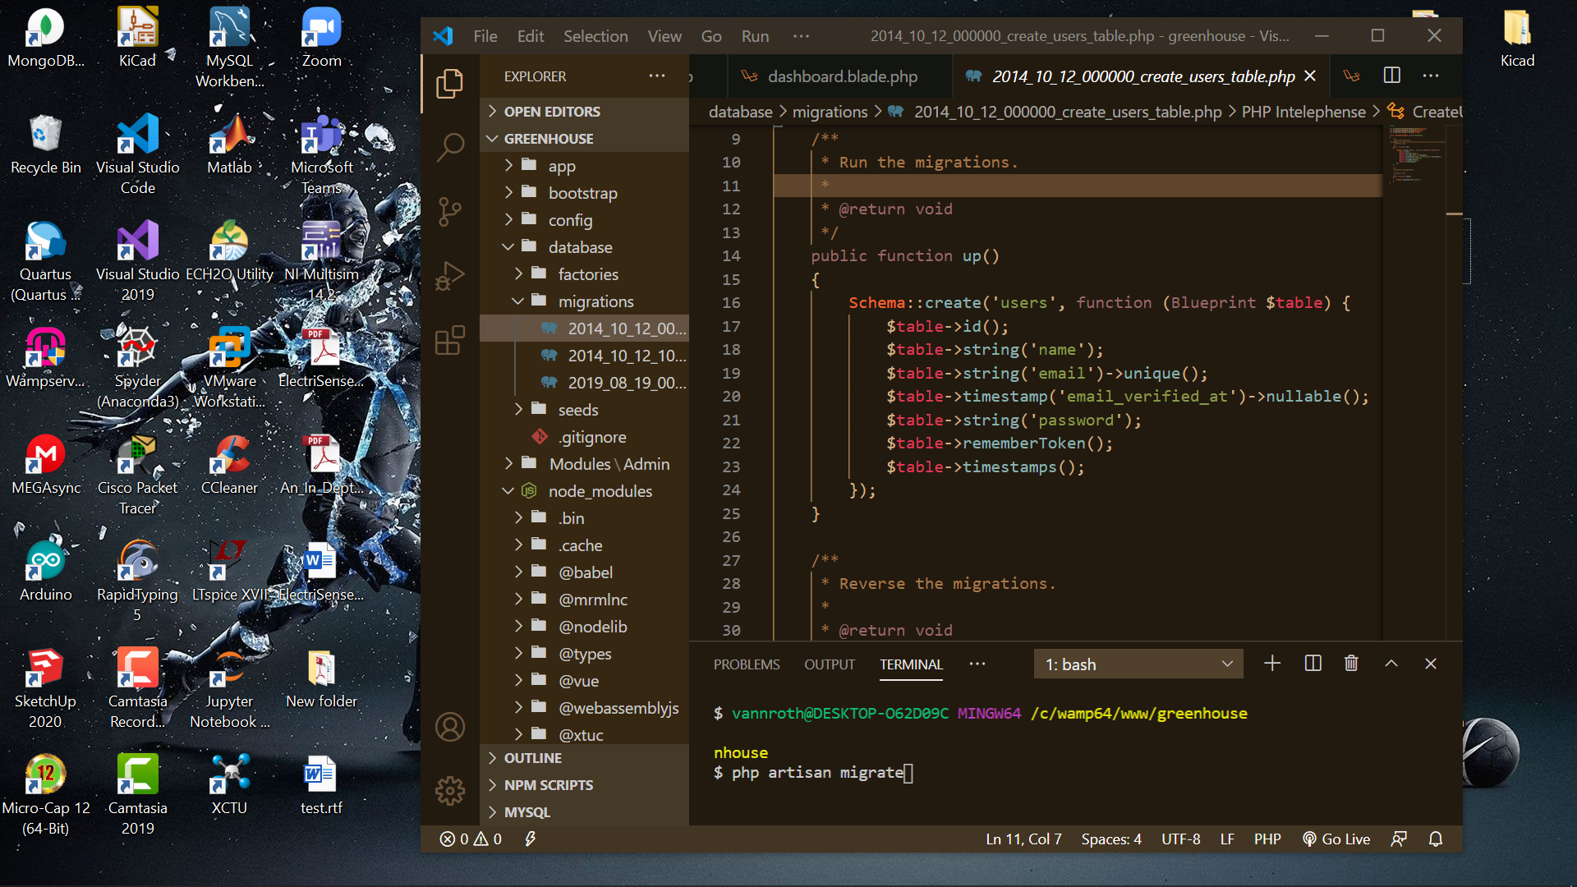
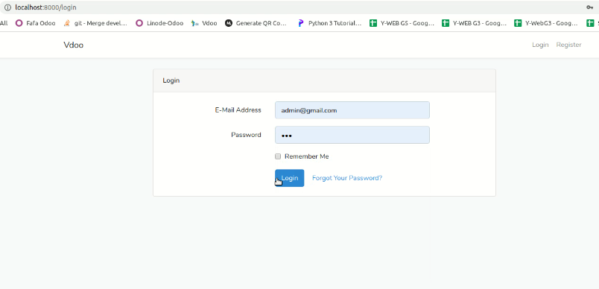
Creating User Login and Register
Stage1 Run migration for user login (Make sure already create database as greenhouse)
$ php artisan migrate
Stage2 Generate user login in Laravel 7
$ composer require laravel/ui
$ php artisan ui bootstrap –auth
$ npm install && npm run dev
https://www.itsolutionstuff.com/post/laravel-6-auth-login-with-username-or-email-tutorialexample.html
After Run Command
PAGE 04

Slide 6
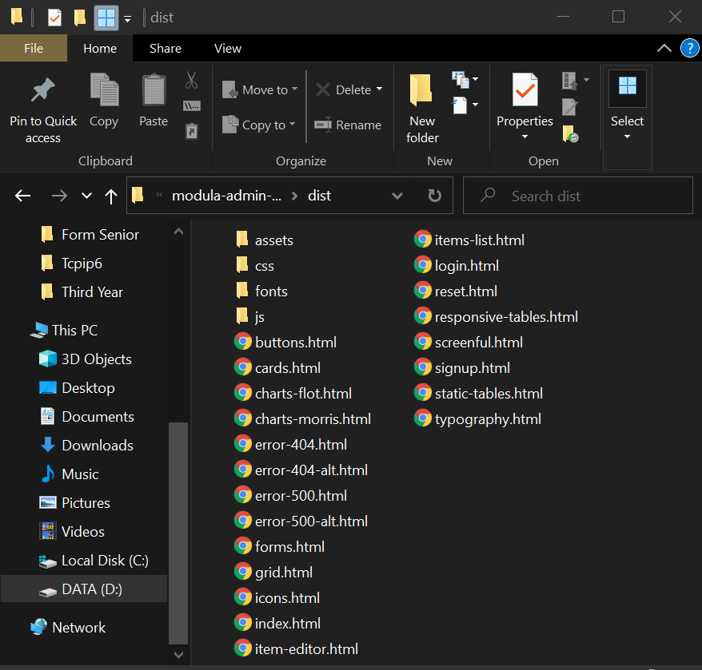
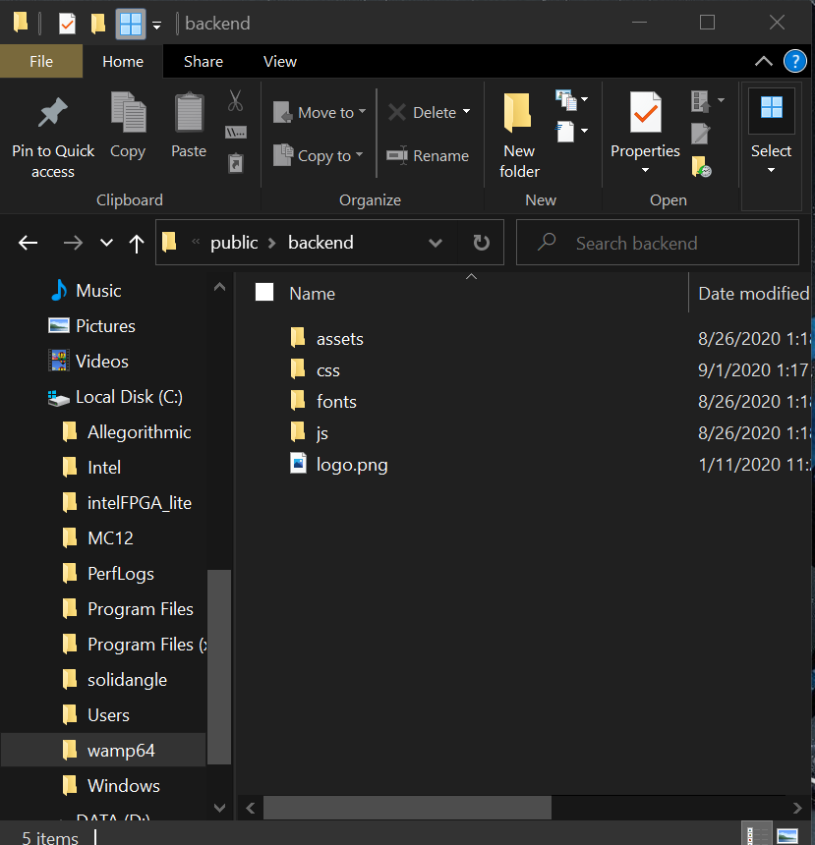
Starting apply Admin Template for User login
Create new folder as backend in greenhouse\public and copy all folder in admin template and paste in folder greenhouse\public\backend.
https://github.com/Chanthan89/Smart-Irrigation/tree/master/Weekly%20Presentation/Sept-2020/VANNAK%20Sovannroth/User%20Login
PAGE 05

Slide 7
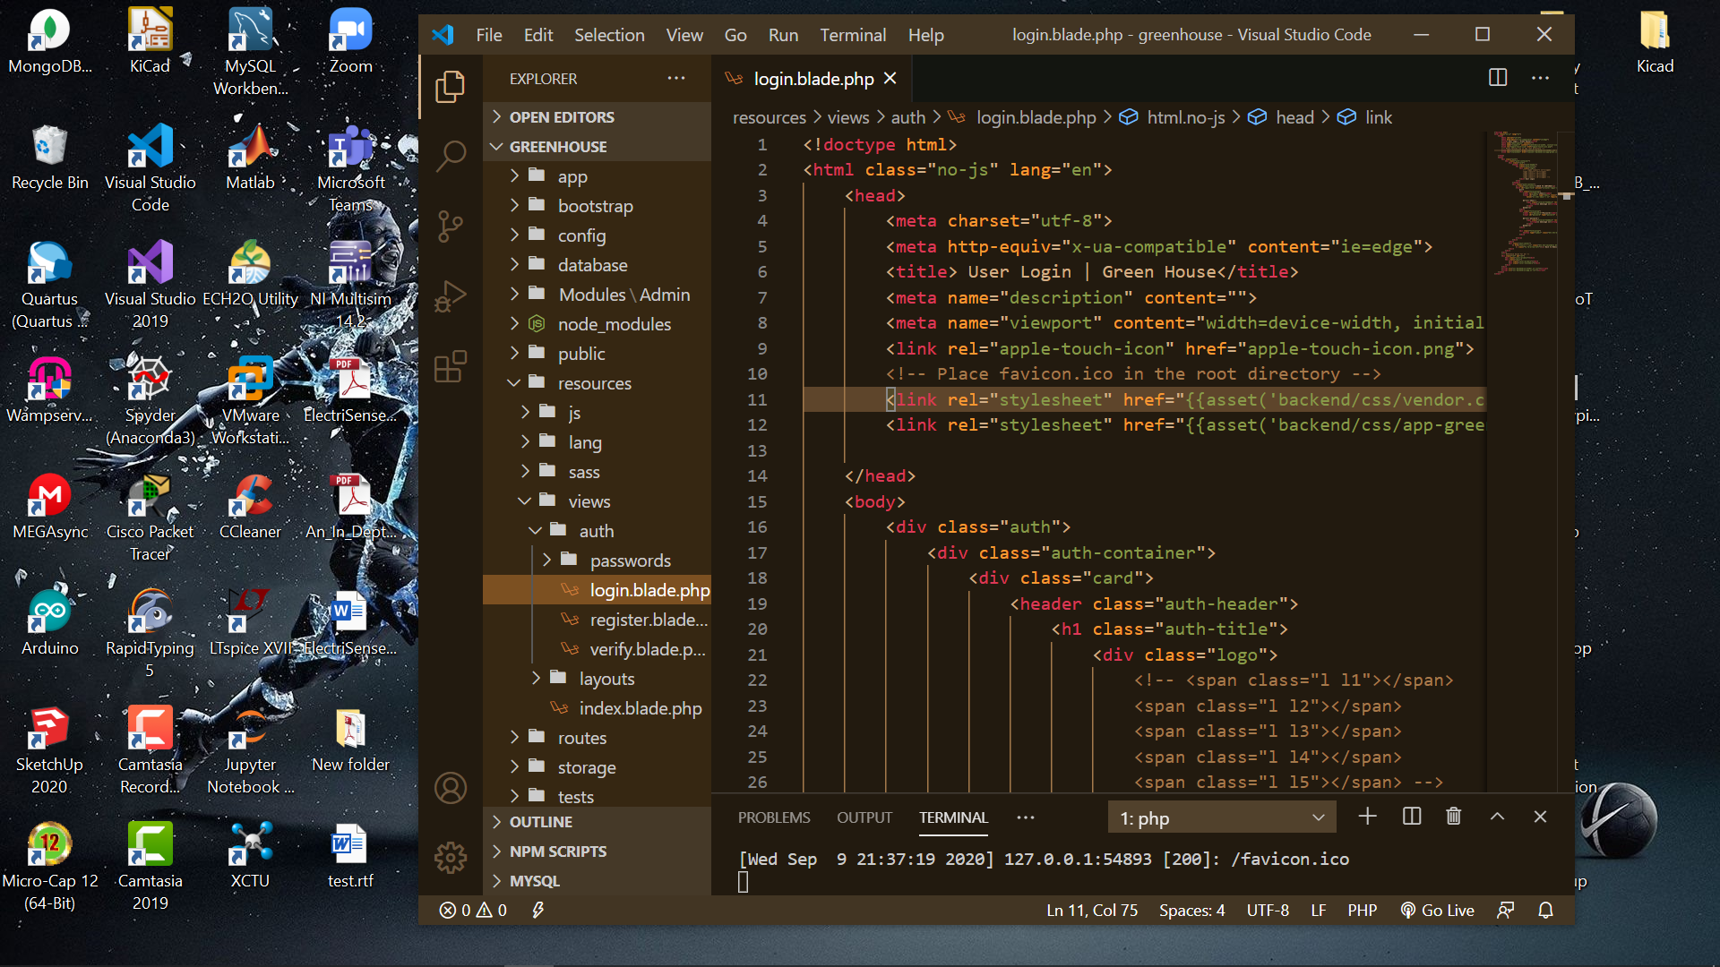
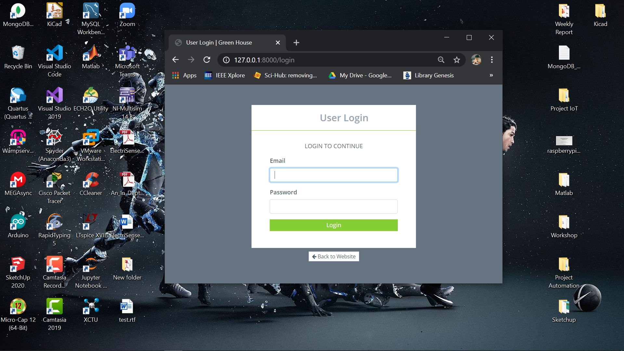
Starting apply Admin Template for User login
Open file login.html with VS code and copy code to login.blade.php, and then edit link with old code and new code.
PAGE 06

Slide 8
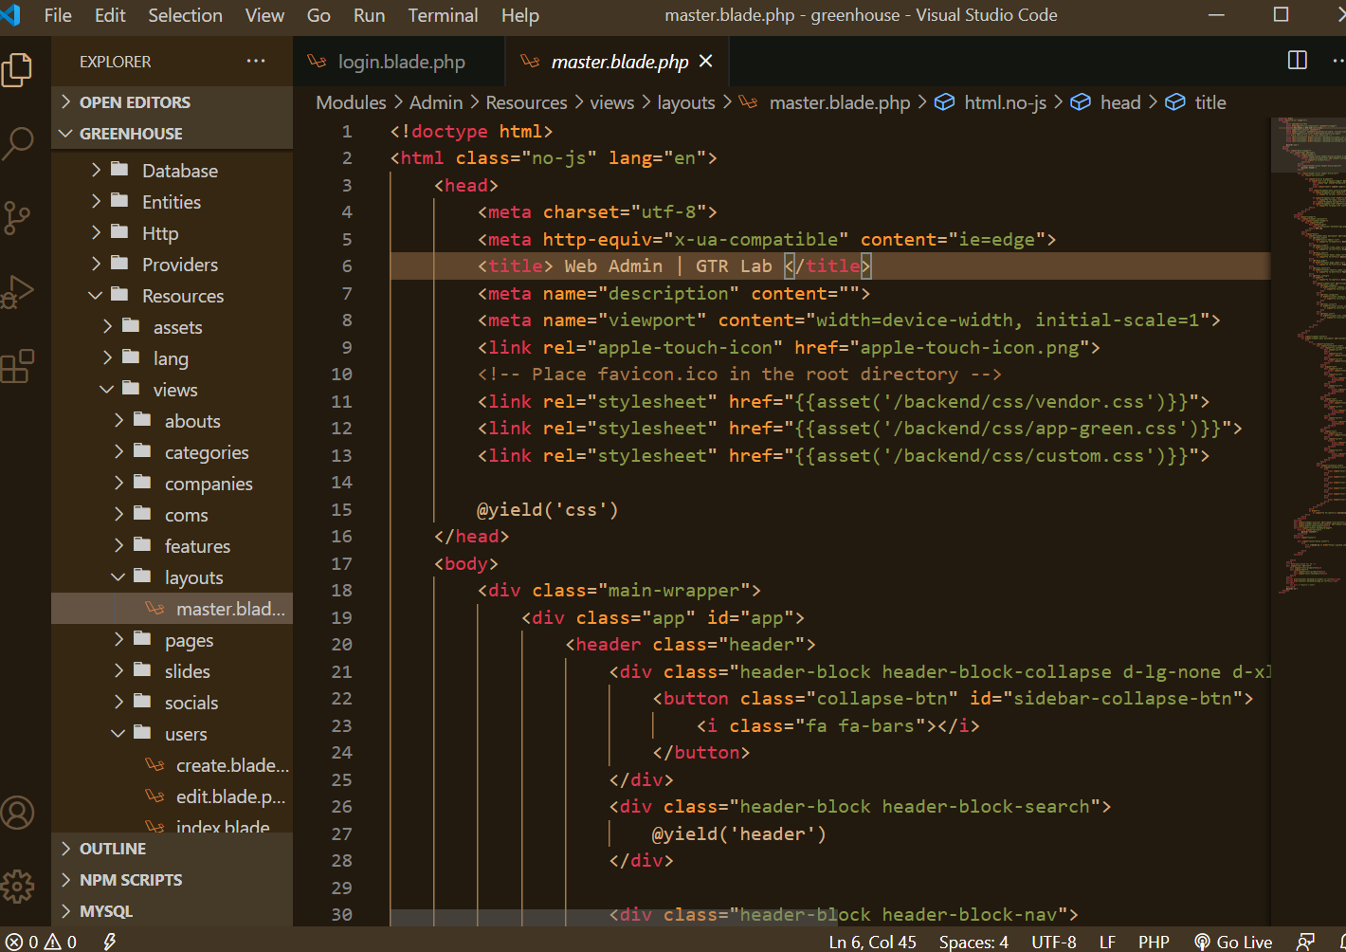
Starting apply Admin Template for Backend
Open file index.html with VS code and copy code to master.blade.php in Module for backend, and then edit link with old code and new code.
https://github.com/Chanthan89/Smart-Irrigation/tree/master/Weekly%20Presentation/Sept-2020/VANNAK%20Sovannroth/Create%20Admin
PAGE 07

Slide 9
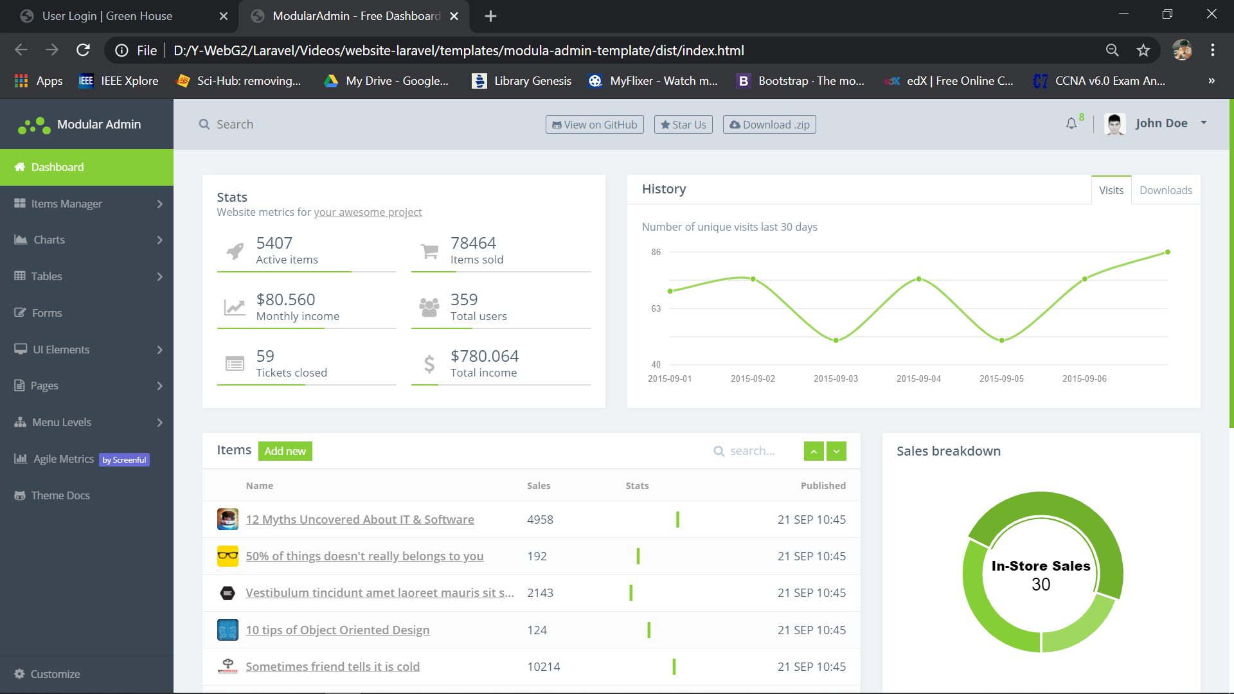
Starting apply Admin Template for Backend
PAGE 08

Slide 10
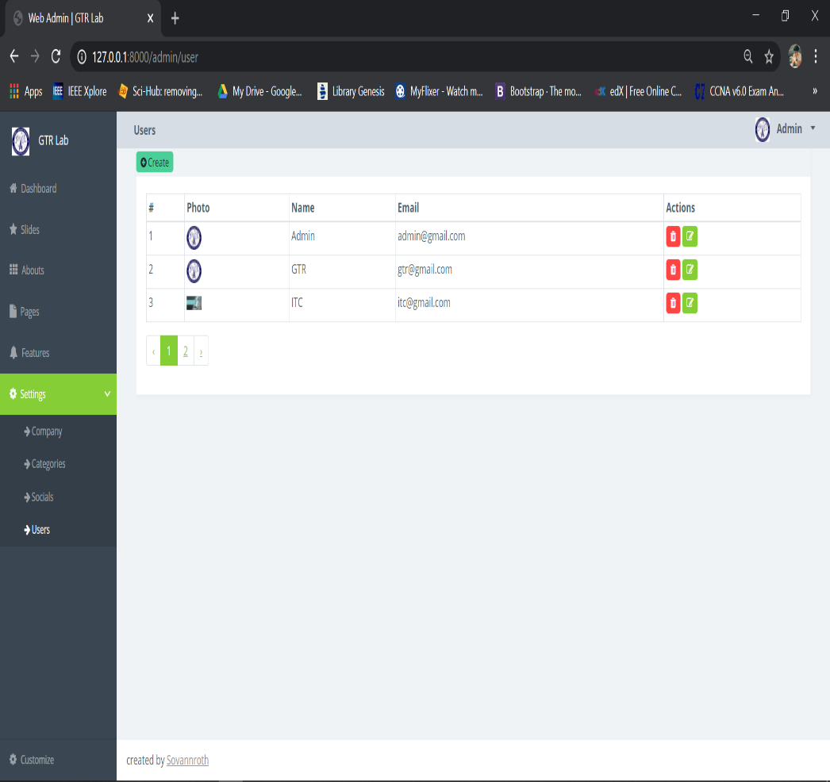
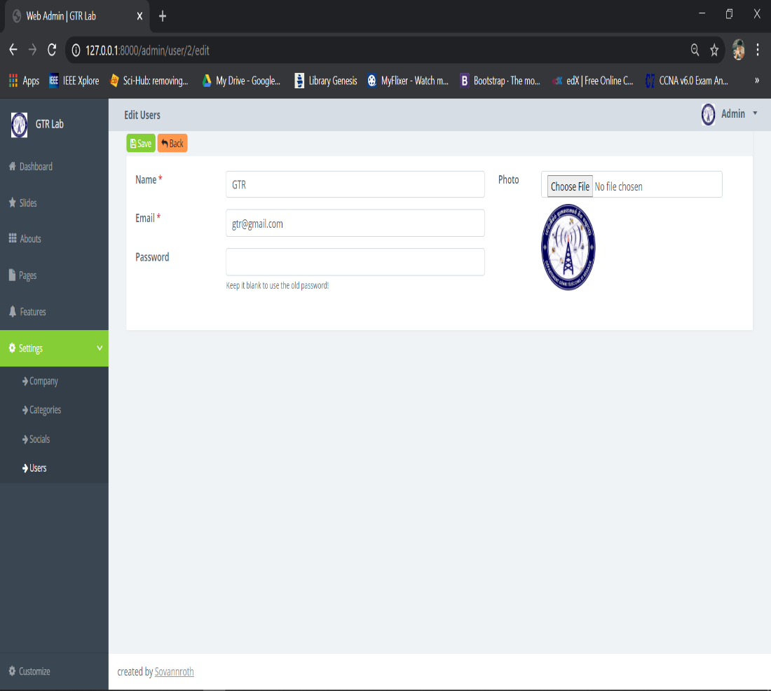
Creating User (create, edit & delete) on backend connect to database
PAGE 09

Slide 11
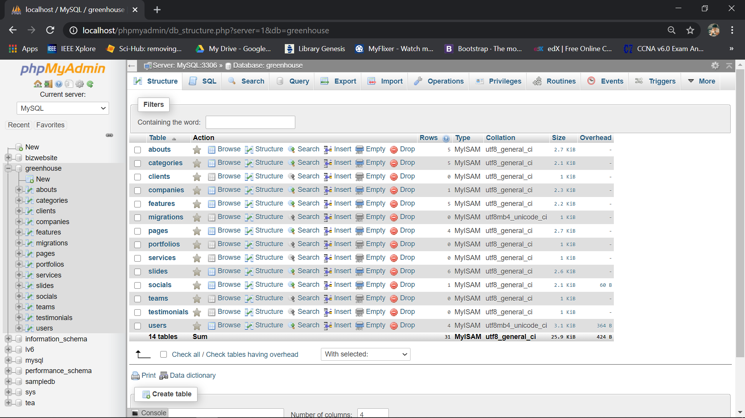
Creating User (create, edit & delete) on backend connect to database
PAGE 10

Slide 12
Creating User (create, edit & delete) on backend connect to database
Create User, Category, Company, Social, and About below link:
https://github.com/Chanthan89/Smart-Irrigation/tree/master/Weekly%20Presentation/Sept-2020/VANNAK%20Sovannroth
PAGE 11

Slide 13
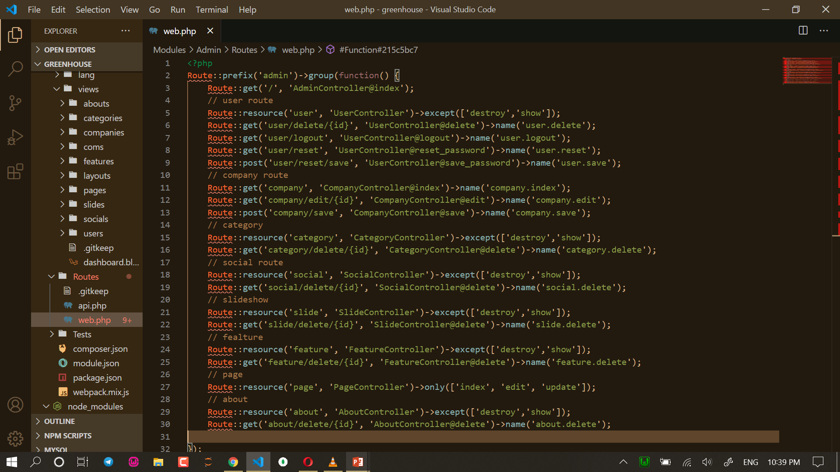
Creating Route of User, Category, Company, Social, and About.
PAGE 12

Slide 14
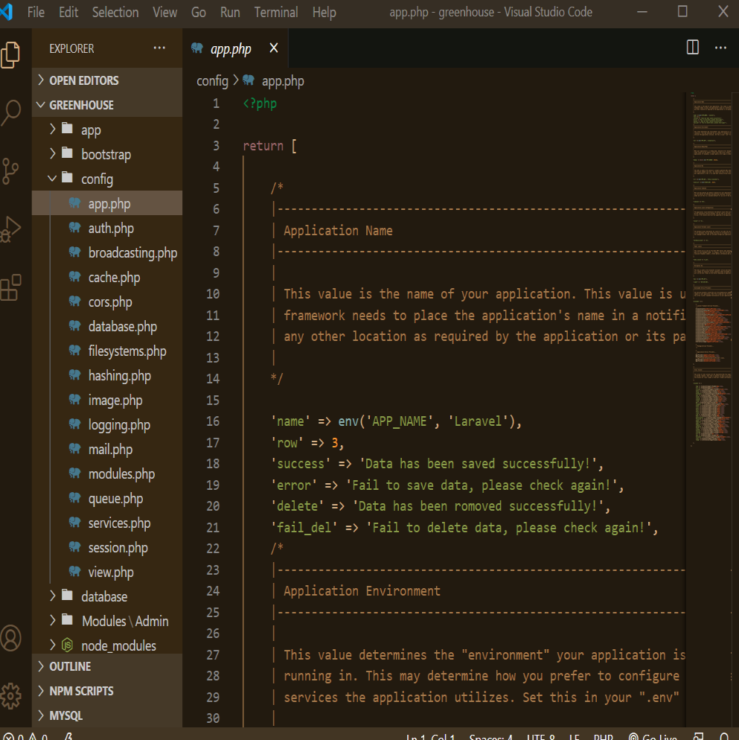
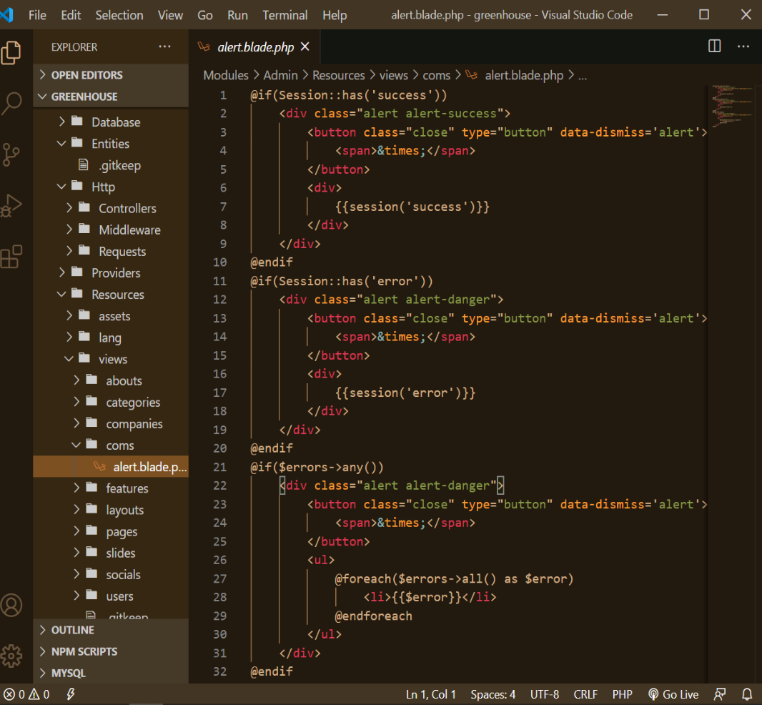
Creating Alert Message
PAGE 13

Slide 15
Thank You!

